Slide 2

Dyslexia Awareness Week (#DAW25)
#DAW25 is all about raising the volume on dyslexia.
How much do you know about dyslexia? Can you tell what is true and what is false?
Try this simple quiz and find out how much you really understand.

Slide 3


Question 1
One in 10 people have dyslexia! That’s like saying if your class has 30 children, about 3 of your class-mates may have dyslexia:
True
False
REVEAL

Slide 4

Dyslexia affects 1 in 10 people.
True
That means that over 1 million young people in schools across the UK have dyslexia. At least three people in every classroom, and many people don’t realise they have it.

Slide 5
Question 2
Dyslexia just means that you find it hard to read.
True
False
REVEAL

Slide 6
False
Dyslexia makes it harder for some people to read, write and spell. It might also be harder to remember things such as homework that has been set, or the date that you need to hand it in.

Slide 7
Question 3
Every dyslexic person has the same strengths and challenges:
True
False
REVEAL

Slide 8
False
In the same way that all of us are unique. Dyslexia is different for everyone. Each person has their own strengths and challenges.

Slide 9
Question 4
People with dyslexia can be amazing puzzle solvers and creative thinkers (kind of like detectives or inventors!)
True
False
REVEAL

Slide 10
True
Dyslexic people think differently and are often good at solving puzzles or finding creative solutions to a problem.

Slide 11
Question 5
Guess what? Spider-Man himself (Tom Holland) is dyslexic!
True
False
REVEAL

Slide 12
True
It’s true! The actor who plays Spider-Man, Tom Holland was diagnosed with dyslexia when he was 7 years old. He also has ADHD.
Sony pictures: https://variety.com/2025/film/news

Slide 13
Question 6
Dyslexic people see words backwards, like looking in a mirror:
True
False
REVEAL

Slide 14
False
This isn’t right, although lots of people think this. Dyslexia affects how the brain processes letters and words. It does not affect your eyesight.

Slide 15
Question 7
Having dyslexia means that you aren’t clever:
True
False
REVEAL

Slide 16
False
This is definitely wrong.
Dyslexia has nothing to do with intelligence. Lots of dyslexic people are super smart and creative. Dyslexic brains are behind many of our best inventions and well-known brands.

Slide 17
Question 8
Maths can sometimes feel extra tricky for people with dyslexia.
True
False
REVEAL

Slide 18
True
This is right.
Around 60% of dyslexic people find it more difficult to learn maths.

Slide 19
Question 9
If you just try harder, dyslexia will go away.
True
False
REVEAL

Slide 20
False
Definitely false. Trying harder doesn’t work, dyslexic people need to learn things in different ways. Dyslexia is life-long but with help at school, people find out how to use their own strengths to help with things that they find challenging.

Slide 21
Question 10
Being dyslexic is cool!
True
False
REVEAL

Slide 22
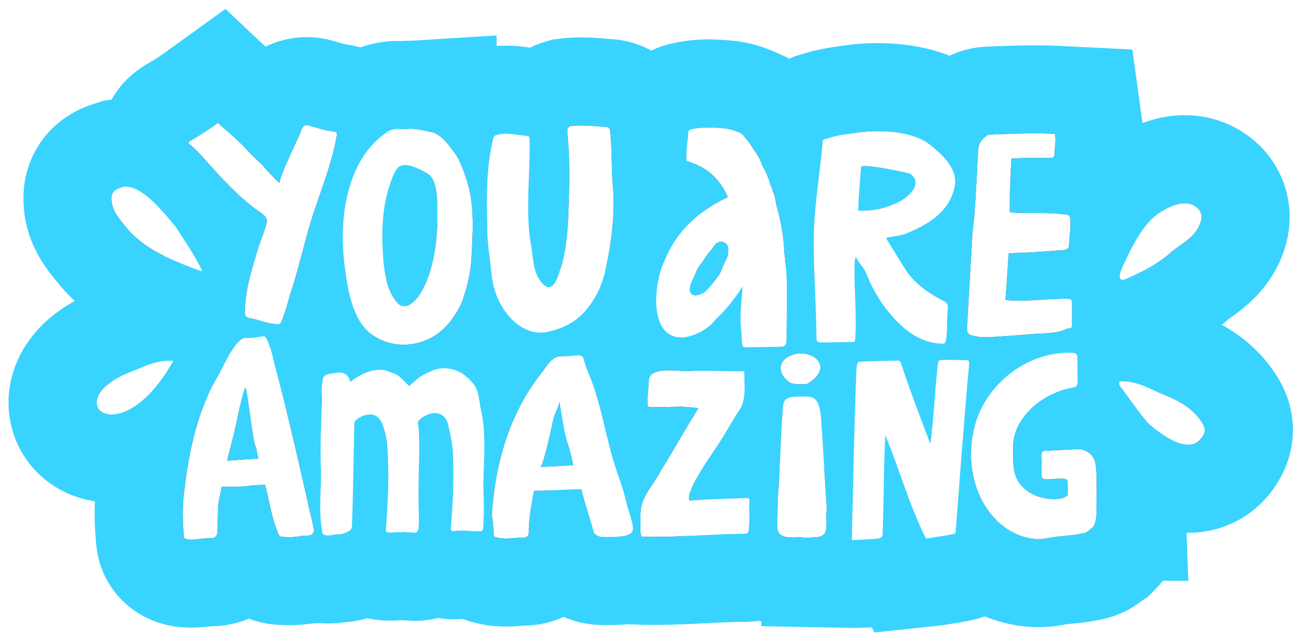
True
We think it is cool and although it can make things a bit difficult sometimes, it can also help you do things that lots of other people are not able to do.
We think it is great that we are all unique and bring our own amazing personalities to everything we do!

Slide 23
