Slide 1
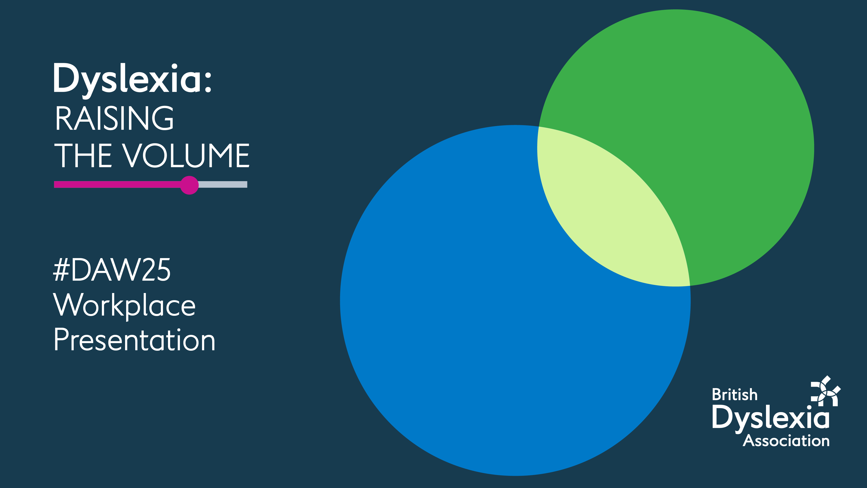

Slide 2
What we will cover
What is dyslexia?
How does it impact the workplace?
Is dyslexia a disability?
What are reasonable adjustments?
Methods of supporting dyslexia in the workplace
How the BDA can offer support

Slide 3





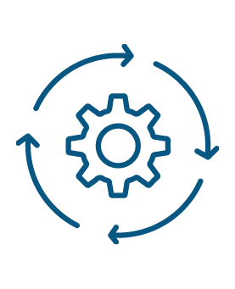
What is dyslexia?
Dyslexia is often hereditary and runs in families.
Dyslexia is not linked to low intelligence.
All dyslexic individuals are very intelligent
It impacts reading, writing, spelling and memory.
The brain processes information differently and gives a different way of thinking.
Each person with dyslexia has unique strengths and challenges.
Dyslexia affects more boys than girls
Many dyslexic people excel in problem-solving, creativity and innovation.

Slide 4
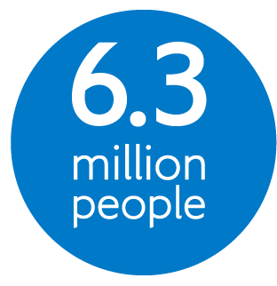
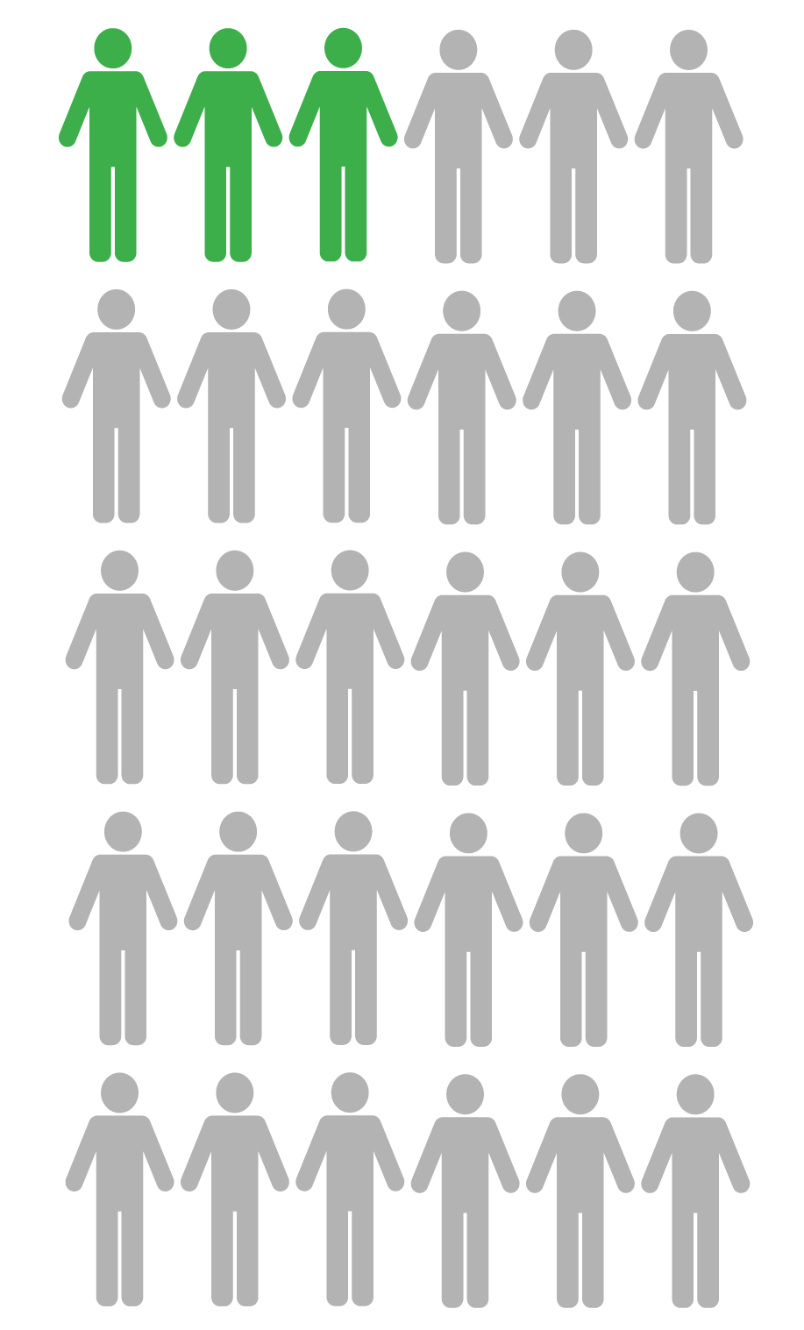
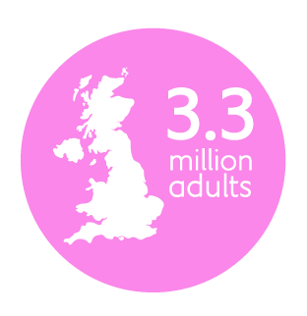
How does dyslexia impact the workplace?
Are estimated to be dyslexic in the UK
3 individuals in a workplace of 30 will experience some form of dyslexia.
In the UK workplace are dyslexic. Many are undiagnosed.

Slide 5

Employers often don’t understand dyslexia and have many misconceptions.
Dyslexia affects 10% of employees but many are undiagnosed. Not always picked up at school and so many have no formal evidence.
No two people are the same. Some will find tasks easy – others unexpectedly challenging
Work environment and role can have an impact

Slide 6

Is dyslexia a disability?
If dyslexia has a substantial and long-term negative effect on day-to-day activities, it can be a recognised disability under the Equality Act 2010
Meets Equality Act criteria for a cognitive impairment
It is lifelong condition – so therefore long-term

Slide 7
Employers must make reasonable adjustments to make sure workers with disabilities, or physical or mental health conditions, are not substantially disadvantaged when doing their jobs.
This applies to all workers, including trainees, apprentices, contract workers and business partners.

Slide 8
What is a reasonable adjustment?
What’s considered reasonable depends on the situation and will vary for each person and each organisation.
It will depend upon things like:
The impact of dyslexia on the job role
How effective the adjustment will be
The size of the organisation
The cost of the adjustment

Slide 9
Reasonable adjustments
Amendments/opt outs from policies
e.g., Hot desking/remote working, use of mobile phones.
Specialist software or equipment
e.g., screen reading or dictation software.
Training, coaching or mentoring
e.g., workplace strategy coaching from dyslexia specialist. Assistive Tech training.

Slide 10
Workplace needs assessments
Looks at specific roles and individual challenges
Can be helpful in new roles
Provided by private providers or Access to Work
Access to Work
Publicly funded service
Dyslexic individual applies
Carry out some assessments (may be phone-based)
Grants for AT, training, coaching and employer awareness training

Slide 11


Ideas to help workplace tasks
Creating templates for report writing
Recording online meetings’
Using transcription in Zoom or Teams
Providing agendas and documentation in advance
Using diary reminders on phone or laptop
Many reasonable adjustments work for all

Slide 12
Ideas to help with concentration
Turn off notifications
Switch off Teams chat
Switch phone to voicemail or focus mode
Use noise cancelling headphones
Build in frequent rest breaks

Slide 13



Support from Assistive Technology
READING
MEMORY
WRITING
Use Assistive Technology
Reading pens
Screen colour changer
Webpage declutter function on google
Electronic calendars
Notes feature
Stories/ mnemonics
To do list apps
Mobile phone alarms/reminders
Post it note apps
Touch typing skills
Transcribe apps will help in virtual meetings
Grammar apps
Mind maps

Slide 14

BDA workplace pledge
The Workplace Pledge is a practical, self-guided framework that helps organisations make meaningful and lasting change.
The Pledge gives you the tools to nurture a positive workplace culture and demonstrate real progress.
Find out more

Slide 15


