Slide 1


Talking about
Dyslexia different minds, different tools
Notes:
These notes are designed to support delivery of the primary presentation. They are conversational rather than scripted word-for-word, so teachers can adapt them to the age and needs of the group.
When talking about strengths, use wording such as “some” or “many dyslexic people” rather than suggesting that all dyslexic people share the same strengths. The same principle applies to challenges. The key message is that dyslexia affects people differently.
Today we are going to talk about dyslexia and about the different ways our brains can learn and do things.
We are all different. Some things might feel easy for one person and more difficult for someone else. That does not mean one person is cleverer than another.
As we go through, we are going to think about what dyslexia can be like, how we can help each other and some of the tools that can make learning easier.

Slide 2

Why we are here today
Understand dyslexia
Show kindness
Share ideas
What it is and how it can feel.
Support friends who learn differently
Find ways classmates and teachers can help.
Notes:
There are three things we are going to think about today.
First, we are going to understand a little more about dyslexia, what it is and some of the things it can affect.
Second, we are going to think about kindness. If somebody finds something difficult, what can we do to help rather than make it harder?
Third, we are going to share ideas about the different things that can help us learn.
At the end, you will get the chance to create your own everyday toolkit.
Optional prompt: What do you think I mean when I say a “tool for learning”? It does not have to be something you can actually hold.

Slide 3

What is dyslexia?
Dyslexia is a learning difference.
It can affect reading, spelling and how someone remembers, organises or processes information.
Like fingerprints, every individual with dyslexia is unique!
Notes:
Dyslexia is a learning difference.
It can affect things such as reading and spelling, but it can also affect how somebody remembers information, organises things or processes what they have heard or seen.
The important thing to remember is that dyslexia is different for every person. There is not one single way to “look dyslexic” or one list of things that every dyslexic person will find difficult.
Someone can also be really good at something and still need help with something else.

Slide 4



Lots of people have dyslexia
1,000,000 +
school children have dyslexia in the UK
1 in 10 people have dyslexia
That means there may be dyslexic children in many classrooms, sports teams, clubs and friendship groups.
Notes:
Dyslexia is quite common.
Around one in ten people are dyslexic. That means there are more than one million school-aged children in the UK with dyslexia.
So, you are very likely to know somebody who is dyslexic, perhaps at school, in your family, in a sports team or somewhere else.
We should not try to guess who is dyslexic, though. It is personal information and people should be able to choose whether they want to talk about it.

Slide 5
Dyslexia can affect different things
Aa
Reading
Writing
Spelling
Memory
A person can be good at something and still need support with part of it.
Following instructions
Processing information
Organising
Notes:
People sometimes think dyslexia is only about reading, but it can affect a wider range of things.
For one person, spelling might take lots of effort. Another person might find it difficult to remember a long list of instructions. Somebody else might find organising their thoughts or getting started on a task harder.
And someone might find some of these things easy and others difficult.
That is why it is useful to ask, “What would help?” rather than assuming everybody needs the same thing.
Optional question: Looking at these examples, can you think of something that might help with one of them?

Slide 6


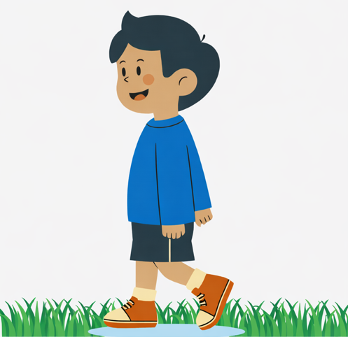

How it might feel?
A very grumpy dragon!
Magical kingdom
Talking
animals
City in
the clouds
Notes:
Imagine you have a brilliant idea for a story. Perhaps it has a magical kingdom, talking animals or a very grumpy dragon.
You know exactly what you want to happen.

Slide 7
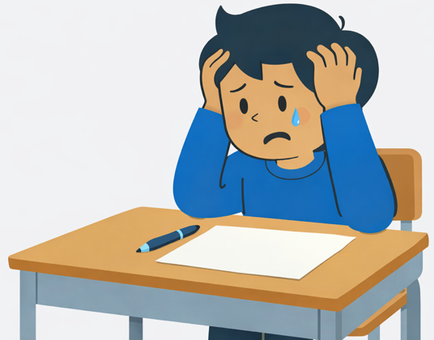
I can’t do this
I’ve lost my ideas now!
I’m stuck on spelling…
my story’s gone
I give up!
Notes:
But while you are trying to work out how to spell the words, it takes so much concentration that some of your ideas start disappearing.
How might that feel?
Give children time to suggest words. You might hear things such as frustrating, tiring, annoying or difficult.
Then ask: what could make that task easier?
The important point is not to pretend this is exactly what dyslexia feels like for everybody. It is simply one example of how a task can become harder when you have to use lots of effort on one part of it.

Slide 8

Strengths can look different too
Imagining ideas
Speaking clearly
Practical thinking
Keeping going
Seeing the
big picture
Solving problems
Notes:
Dyslexic people can also have many different strengths.
Some may be very good at imagining things, seeing the overall picture, practical problem-solving, explaining ideas aloud or finding a different way to approach a problem.
But we need to be careful here. We should not say that every dyslexic person is automatically creative or good at solving puzzles.
Just as the challenges are different for everyone, strengths are different too.
The main message is that finding one thing difficult does not tell us what somebody is capable of.

Slide 9
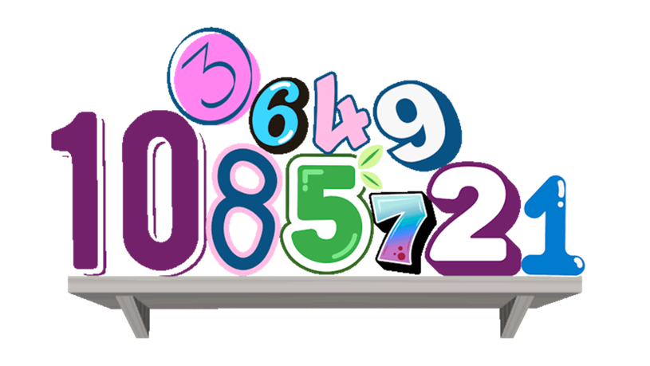
What is a Memory Shelf?
Notes:
Important Notes
1) Many people can remember 8 – 10 things at once
2) Some people with dyslexia can remember 2 – 3 things
Here is one way we can think about short-term memory.
Imagine that there is a little shelf in your brain where you temporarily put information you need to use.
For example, if I said, “Get your maths book, turn to page 20 and answer questions one to five,” you need to hold several pieces of information in your mind.
Here is one way we can think about short-term memory.
Imagine that there is a little shelf in your brain where you temporarily put information you need to use.
For example, if I said, “Get your maths book, turn to page 20 and answer questions one to five,” you need to hold several pieces of information in your mind.
Sometimes that shelf gets full and one of the instructions can fall off before we have used it.
That can happen to anybody. Some people find holding several pieces of information at once more difficult than others.
Optional demonstration: Give the class a simple three-step instruction, then a much longer six or seven-step instruction. Ask which was easier to remember and why.

Slide 10

What is a Memory Shelf?
Notes:
Here is one way we can think about short-term memory.
Imagine that there is a little shelf in your brain where you temporarily put information you need to use.
For example, if I said, “Get your maths book, turn to page 20 and answer questions one to five,” you need to hold several pieces of information in your mind.
Sometimes that shelf gets full and one of the instructions can fall off before we have used it.
That can happen to anybody. Some people find holding several pieces of information at once more difficult than others.
Optional demonstration: Give the class a simple three-step instruction, then a much longer six or seven-step instruction. Ask which was easier to remember and why.

Slide 11
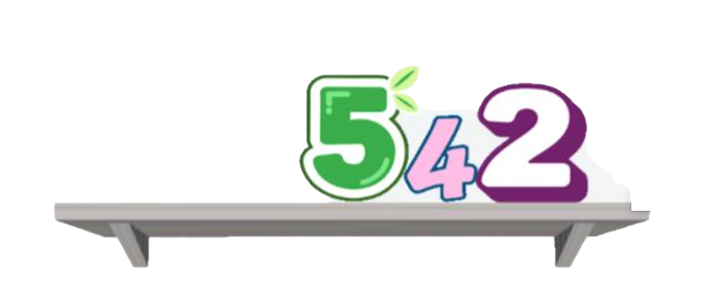
What is a Memory Shelf?
Notes:
That can happen to anybody. Some people find holding several pieces of information at once more difficult than others.
Optional demonstration: Give the class a simple three-step instruction, then a much longer six or seven-step instruction. Ask which was easier to remember and why.

Slide 12

Different minds need different tools
Using a tool is not cheating!
Tools can help someone to take part, to learn and to show what they can do.
Notes:
This is one of the most important ideas today.
Using a tool to help you is not cheating.
We all use tools. We use maps when we do not know the way somewhere. We use alarms to remember to wake up. We use calendars so we do not have to keep every date in our heads.
Learning tools work in the same way.
A picture, checklist, extra thinking time, audiobook or piece of technology can remove a barrier and help somebody show what they actually know and can do.
Different people may choose different tools, and that is completely normal.

Slide 13


How could we help a friend?
“I’m a bit nervous about getting a phone for high-school.
I don’t like using group chats in case someone laughs at my spelling. But I don’t want to miss out on what’s going on”
Azeem
Talk on your table:
what could you do to help and support Azeem?
Notes:
Imagine someone is worried about joining a group chat because they think other people might laugh at their spelling.
They still want to be part of the conversation, but they are worried about getting something wrong.
Talk to the person next to you. What could you do if this was your friend?
Give children a short time to discuss.
Draw out ideas such as not correcting or laughing at spelling, using voice notes, being patient and making sure everybody is included.
The important thing is not to make a big fuss or make someone feel different. Being supportive can be very simple.

Slide 14



Activity: build your everyday toolkit
Choose tools that help you to learn, to communicate, to organise yourself or feel confident
Using pictures
Asking for extra time
Making tasks bitesize
Notes:
Now we are going to think about the tools that help each of us.
Your toolkit might include things that help you learn, remember something, organise yourself, explain your ideas or feel ready to learn.
You might choose pictures, listening to information, talking something through, extra thinking time, a checklist, taking a movement break, somewhere quiet, helpful technology, asking somebody for help or breaking a task into smaller steps.
There is no correct toolkit.
You also do not have to tell the class anything personal that you do not want to share.
You can draw, write, use the cards or work with somebody else.

Slide 15

Your toolkit challenge
1
Choose four or more tools
2
Add them to your backpack
3
Explain why two are useful
You can draw your own, cut out cards, circle choices or work with a partner.
4
Add one classroom change
Notes:
Choose at least four things that would be useful in your toolkit.
Then pick two of them and think about why they help.
For example: “A checklist helps me because I can see what I have done and what I need to do next.”
Finally, think beyond your own toolkit.
What is one change we could make in our classroom that might make learning easier for different people?
It might be giving instructions in more than one way, allowing a little thinking time, using pictures or breaking a long task into smaller steps.
For younger children: Ask them simply to choose or draw the things that help them and complete the spoken sentence, “This helps me because…”

Slide 16



Share and compare
Did everyone choose the same tools?
Why might the same tool help different people in different ways?
What could make our classroom easier for more people?
There is no single right way to learn or get something done.
Notes:
Have a look at the different toolkits.
Did everybody choose exactly the same things?
Probably not, and that is the point.
Something that helps one person might not be useful to somebody else. The same tool might even help two people for completely different reasons.
Ask for a few examples if children are happy to share.
Then ask: what could we do in our classroom to make it easier for lots of different minds to learn?
Reinforce that there is no single “right” way to learn or complete a task.

Slide 17
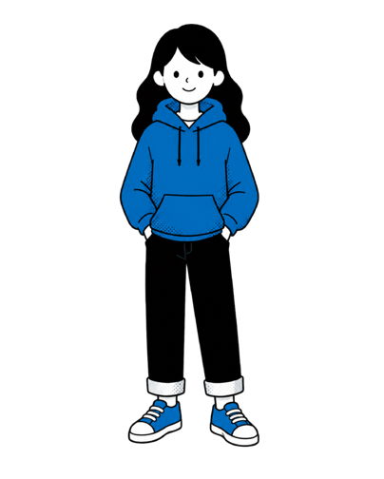
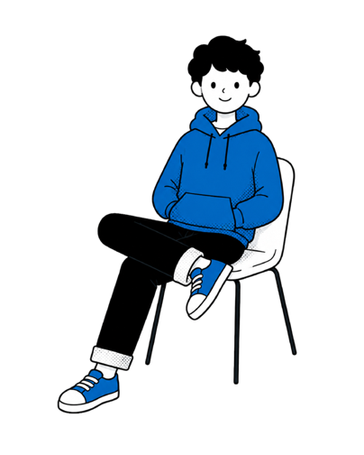
Quiz time: stand up or sit down
Stand up if you think it is
Sit down if you think it is
TRUE
FALSE
Notes:
We are going to finish with a quick true or false quiz.
If you think the answer is true, stand up.
If you think it is false, stay sitting down.
Read each statement one at a time and click to reveal the answer
You can ask one or two children why they chose their answer, but avoid putting anyone on the spot.

Slide 18



Quiz time: stand up or sit down (click question mark)
1 in 10 people have dyslexia?
Dyslexia only means finding reading hard.
TRUE
Dyslexia affects
1 in 10 people.
FALSE
It can affect reading, spelling, memory, organisation, processing.
Notes:
1. One in ten people have dyslexia.
Click for answer: Number one is true. Around one in ten people have dyslexia.
2. Dyslexia only means finding reading hard.
Click for answer: Number two is false. Dyslexia can affect reading and spelling, but it can also affect memory, organisation and processing information.

Slide 19



Quiz time: stand up or sit down
Dyslexic people can be great problem solvers?
Dyslexia means you are not clever.
TRUE
Many dyslexic people are good at finding different ways to solve problems.
FALSE
Dyslexia has nothing to do with intelligence.
Notes:
3. Dyslexic people can be great problem solvers.
CLICK: Number three is true, with an important point. Many dyslexic people are good at finding creative or practical solutions, but not every dyslexic person has the same strengths.
4. Dyslexia means you are not clever.
CLICK: Number four is false. Dyslexia has nothing to do with how intelligent somebody is.

Slide 20
Quiz time: stand up or sit down
Every person with dyslexia is the same.
FALSE
Many dyslexic people are good at finding different ways to solve problems.
Notes:
5. Every person with dyslexia is the same.
CLICK: Number five is false. Every dyslexic person is different.

Slide 21

To recap
Dyslexia is a learning difference.
Dyslexic people are not all the same.
Different people may need different tools, explanations or amounts of time.
Kindness helps everyone learn.
Notes:
So what are the four things I would like you to remember?
Dyslexia is a learning difference.
It affects different people in different ways.
Different people sometimes need different tools, explanations or amounts of time.
And one of the simplest things all of us can do is be kind and patient with people who may learn differently from us.
Possible closing question: What is one thing you will remember from today?
Or, for a class session, finish the sentence together: “In our class, we can help different minds by…” Record some of the children’s ideas if appropriate.

Slide 22
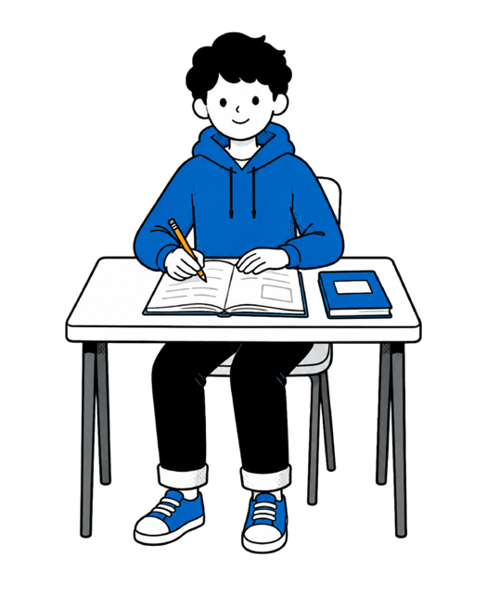
In our class, we can help different minds by…

Slide 23



Remember

Slide 24


